Slide 1
Secure Settings – Apply Options
AVCDL-Implementation-3.1.4
Charles Wilson
Staff Product Cybersecurity Architect
version 1
2025-09-23
Notes:
Script:
I'm Charles Wilson, staff product cybersecurity architect at Torc Robotics.
This presentation will cover the Secure Settings – Option Application activity.

Slide 2
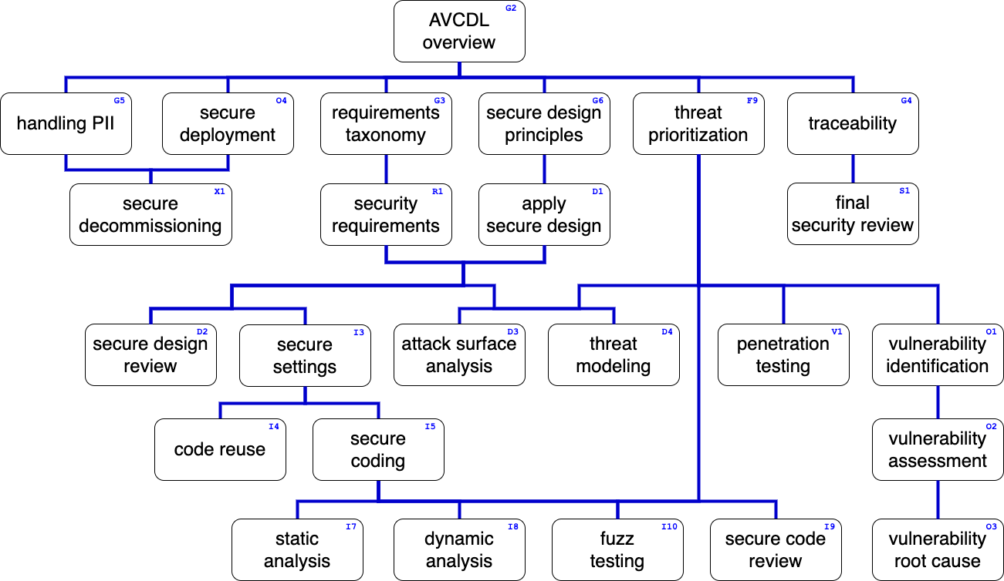
Training Path
Notes:
Script:
This diagram shows the overall AVCDL training path.
If you're taking this training, it's assumed that you've already completed the AVCDL Overview training,
and additionally, that you've completed the
Requirements Taxonomy
Security Requirements
Secure Design Principles
Apply Secure Design
Secure Settings Overview
Secure Settings – Identify Options
Secure Settings – Categorize Options
and
Secure Settings – Select Options
trainings.
This training will cover the Secure Settings – Option Application activity.

Slide 3
Introduction
Notes:
Script:
Before getting into option application, let's briefly review where it fits, in the overall secure settings process.

Slide 4
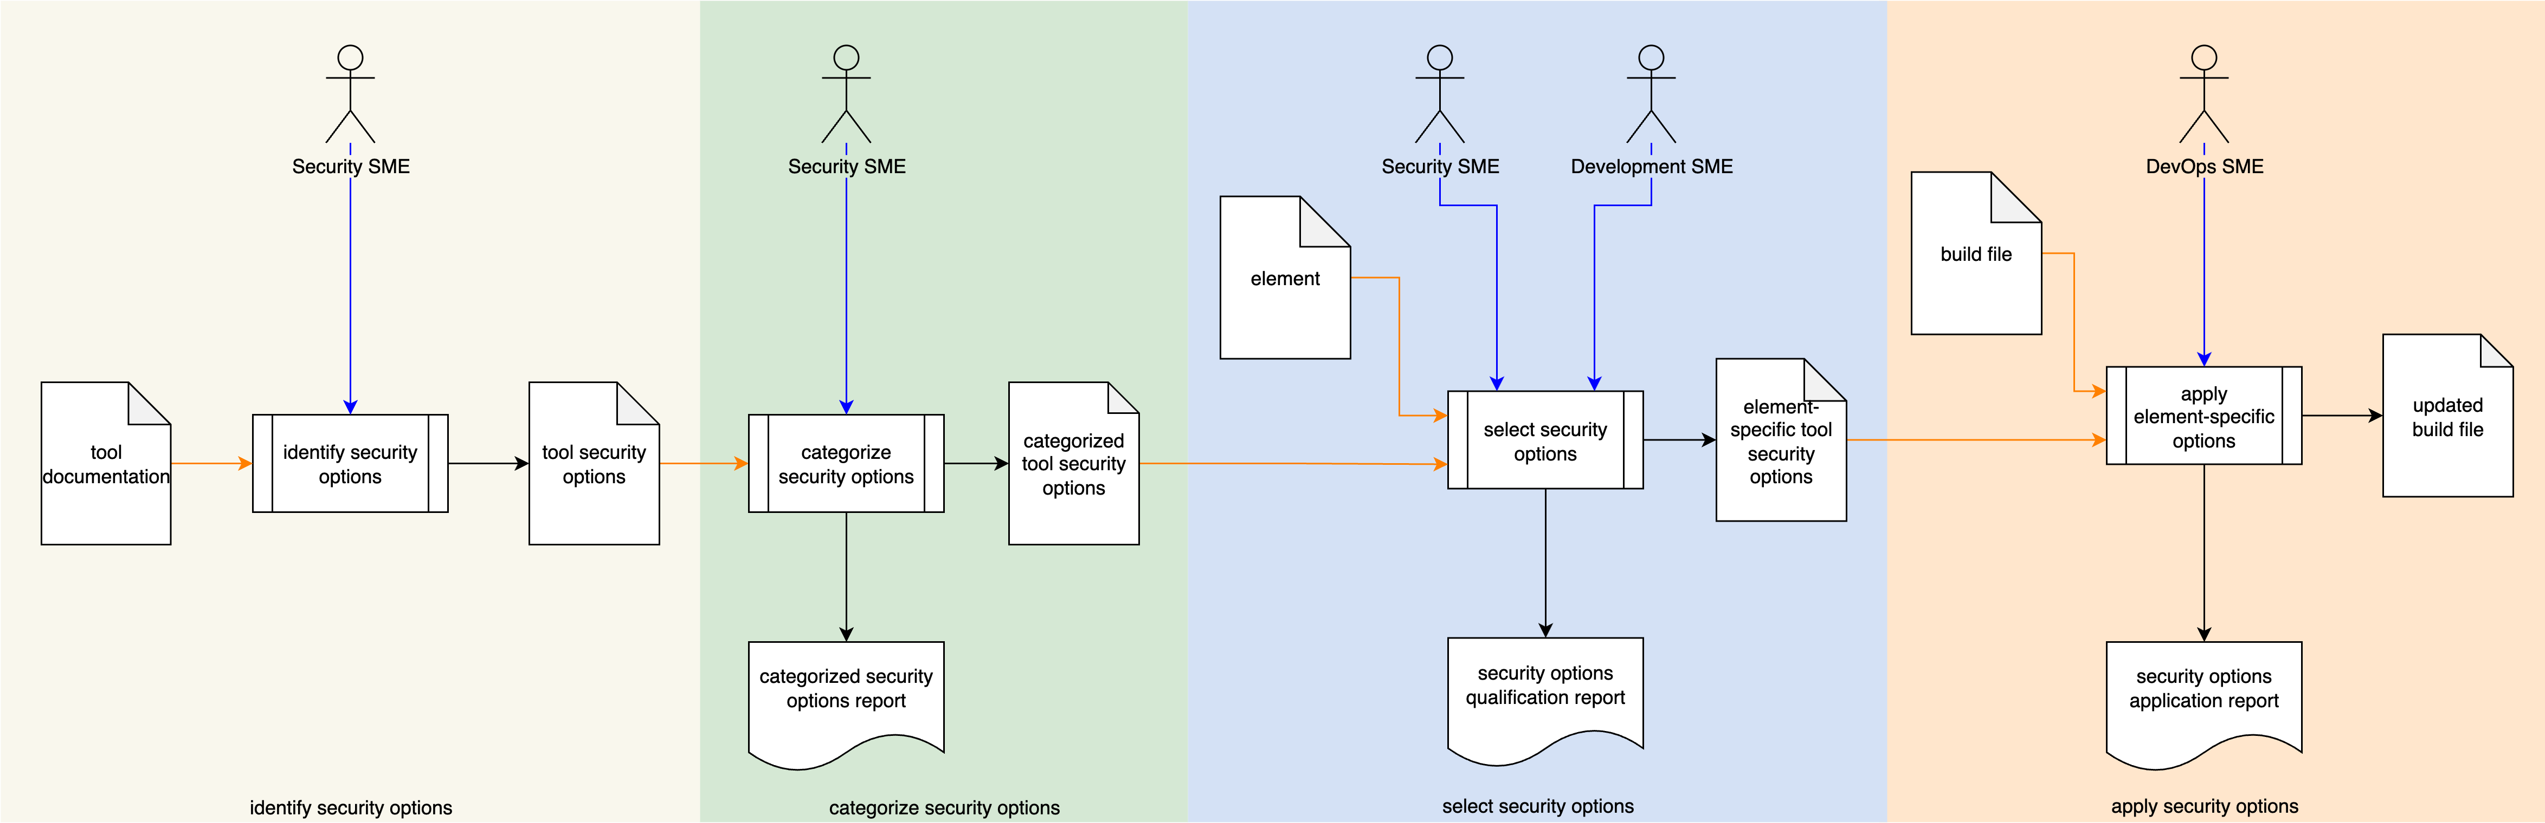
Secure Settings Process
Notes:
Script:
Here's the secure settings process which we previously covered in the Secure Settings Overview.
[break]
Our focus for this training is going to be on the fourth activity, that of option application.

Slide 5
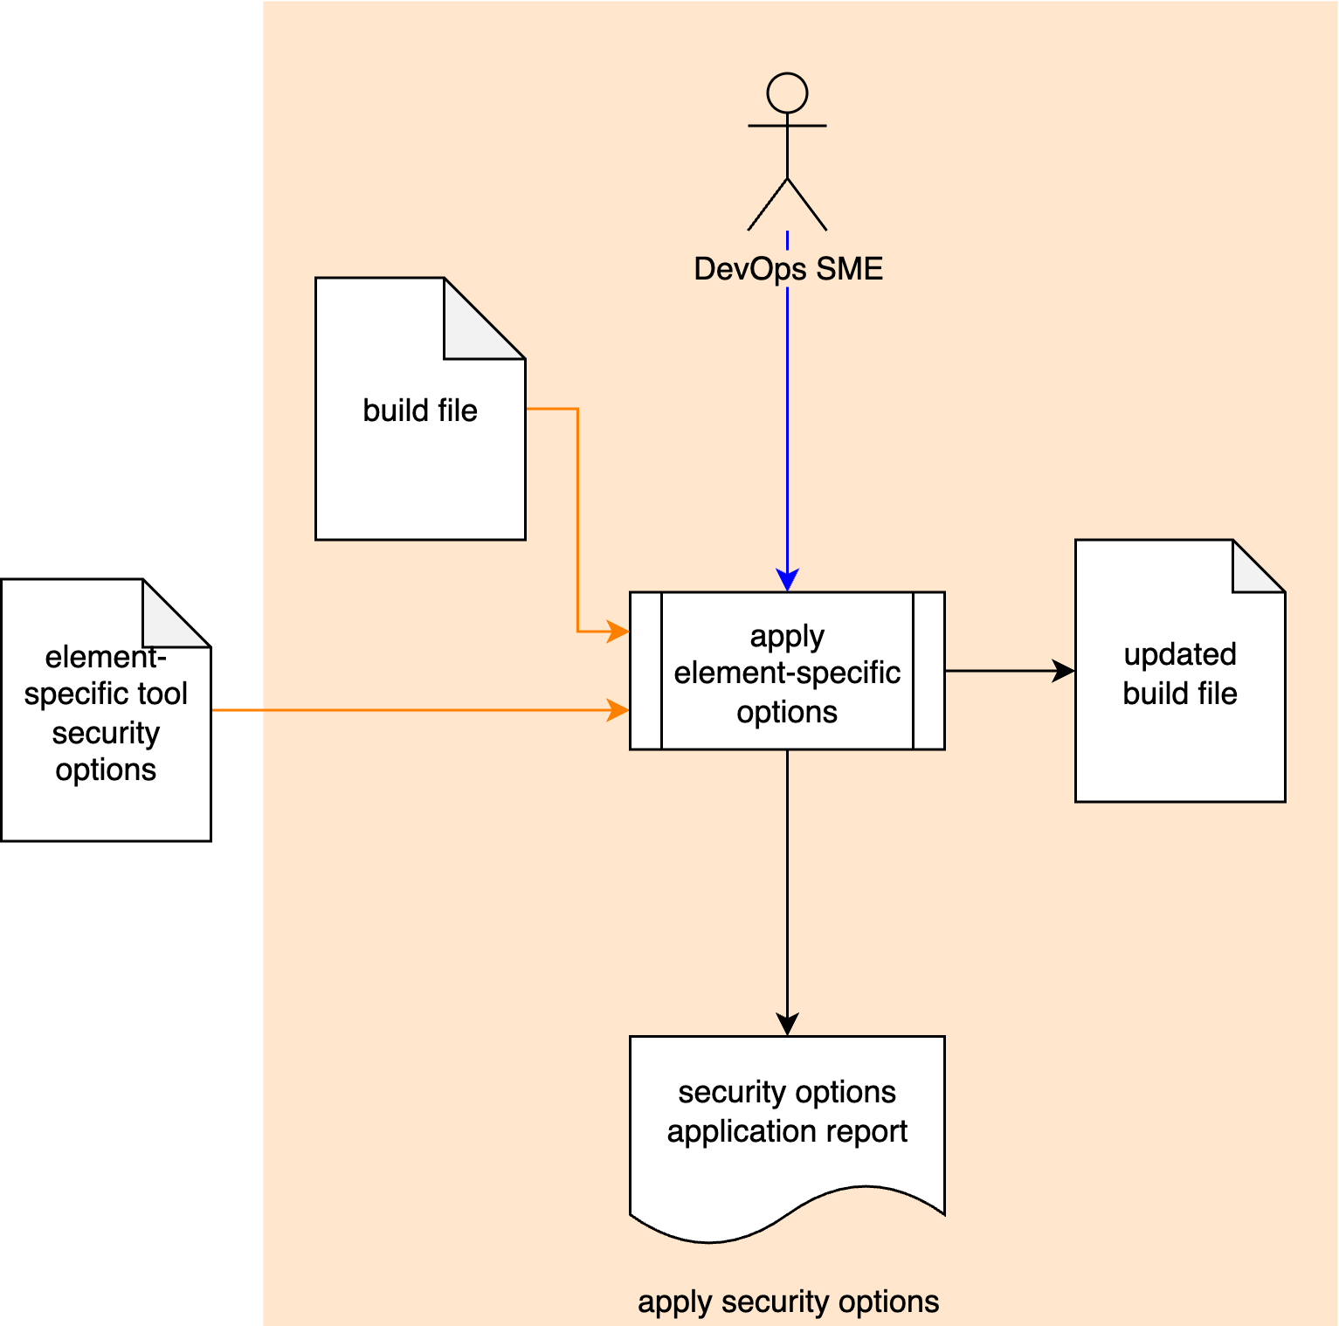
Secure Settings Process
Notes:
Script:
Here's the secure settings process which we previously covered in the Secure Settings Overview.
[break]
Our focus for this training is going to be on the fourth activity, that of option application.

Slide 6
Apply Options Activity
Notes:
Script:
Within the option application activity,
The devops SME takes
[pause]
the element-specific tool security document from the option selection activity,
[pause]
and the build file
[pause]
and applies the security options to the appropriate element’s section,
[pause]
creating an updated build file
[pause]
and generating a security options application report.

Slide 7
Example
Notes:
Script:
Now let's work our way through an example of a tool's cybersecurity-relevant option application.
We'll be working with the element-specific tool cybersecurity options document created in the option selection activity.
It's important to note here that this is just one mechanism for documenting this information.
There are any number of ways the information could be documented.
In an ideal world, you'd use a database to store the information both across tools and versions of tools and aligned with each element.
If a database is used, the information needed by the DevOps SME should be exported into a flattened representation.

Slide 8
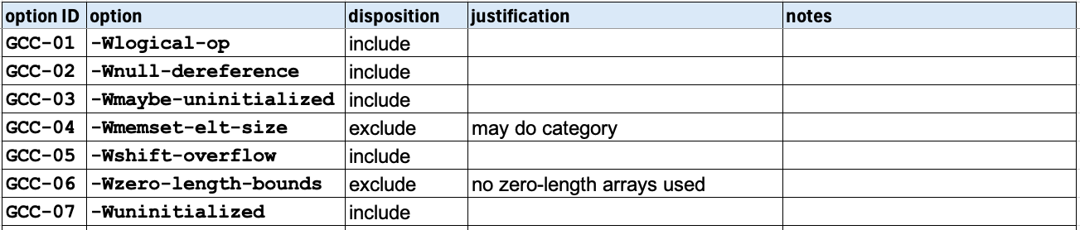
Options
Notes:
Script:
Here are the options from the elements-specific tool cybersecurity options document.
The part that we need to make sure that the DevOps SME gets are just the first three columns,
the option ID,
the option,
and the disposition.
We don't need the justification or notes fields.
It might be useful to sort this based on the disposition, and then the option, but that’s an individual preference.
You could simply provide the elements that are to be included.
But, if you want to make sure that the ones that you wanted to be excluded aren't already turned on, then having both is useful.
I'm not going to go into build system-specifics here.
And the fact that we're talking about these options going into build file, does not preclude them from going into the settings of a standalone tool being used within the context of the build system.
There are going to be some tools, static analyzers are a good example, which have configuration files that are managed separately from the build system.
That's not a significant thing.
What's important is that we provide the options, whatever the mechanism of application.
That’s the core point we're trying to get at here.
Since the DevOps engineer is presumed to be a subject matter expert in how the build system works and how the tools within it are being utilized, so long as we provide the tool options list and the contextual information about the tool and element to which it needs to be applied, there's sufficient data to perform this activity.
It’s presumed that before deploying the changes, that the DevOps SME will verify that the changes to the settings do not break the build.

Slide 9
Report
Notes:
Script:
The final step in this activity is the generation of the security options application report.
This requirement is one of the greatest sources of confusion in this activity.
So, let's talk about that.

Slide 10
Human-readable Report
Traceability
Setting enforcement
Notes:
Script:
There are two motivations for the report generation exercise.
The first is unsurprisingly one of traceability.
We want to be able to show that we have applied the specified settings.
This shouldn’t require anything outside of the normal settings report that one would produce in order to present in a regulatory context.
The second is settings enforcement.
This treats this human-readable form as a helper document.
We want to ensure that once we have made these settings an established part of the build that they don't get changed.
And so, this provides us with a document that we can reference.
It says, “these are the settings that should be there, let's check to see if that's the case.”
[pause]
Many are probably thinking, “Can’t we just tell people to look at the build file? It’s self-documenting.”
For those operating in non-regulated industries, this aspect of the apply options activity is probably one you can skip.
For everyone else, keep in mind that having a report in the DMS avoids the data extraction issues that come into play when there is a problem five or ten years in the future requiring review of the cybersecurity settings.
If the build process includes a step which generates a human-readable form documenting the settings information, then this is easily recorded in the DMS.
This report would be part of the product build documentation.
Should a problem arise in the future, no one needs to stand up the source code control and build systems necessary to extract and report this information.
This step is fundamentally about the future-proofing.

Slide 11
Recap
Notes:
Script:
And that covers the final activity in the secure settings process.
Let's look at some takeaways.

Slide 12
Summary
Apply settings
Verify build
Create a human-readable report
Notes:
Script:
This activity is probably the most straightforward one of all the secure settings activities.
It consists of:
[pause]
applying the settings to the build
[pause]
verifying the build before deploying it
[pause]
and finally, creating a human-readable report for the purposes of traceability, and also to later ensure that the settings stick.

Slide 13
Example Materials
<AVCDL>/source/reference_documents/working_material/secure settings/
Notes:
Script:
The materials that were used to cover this example are in the location shown here.
It's important to note that the workbook includes all the sheets covered in this training.

Slide 14
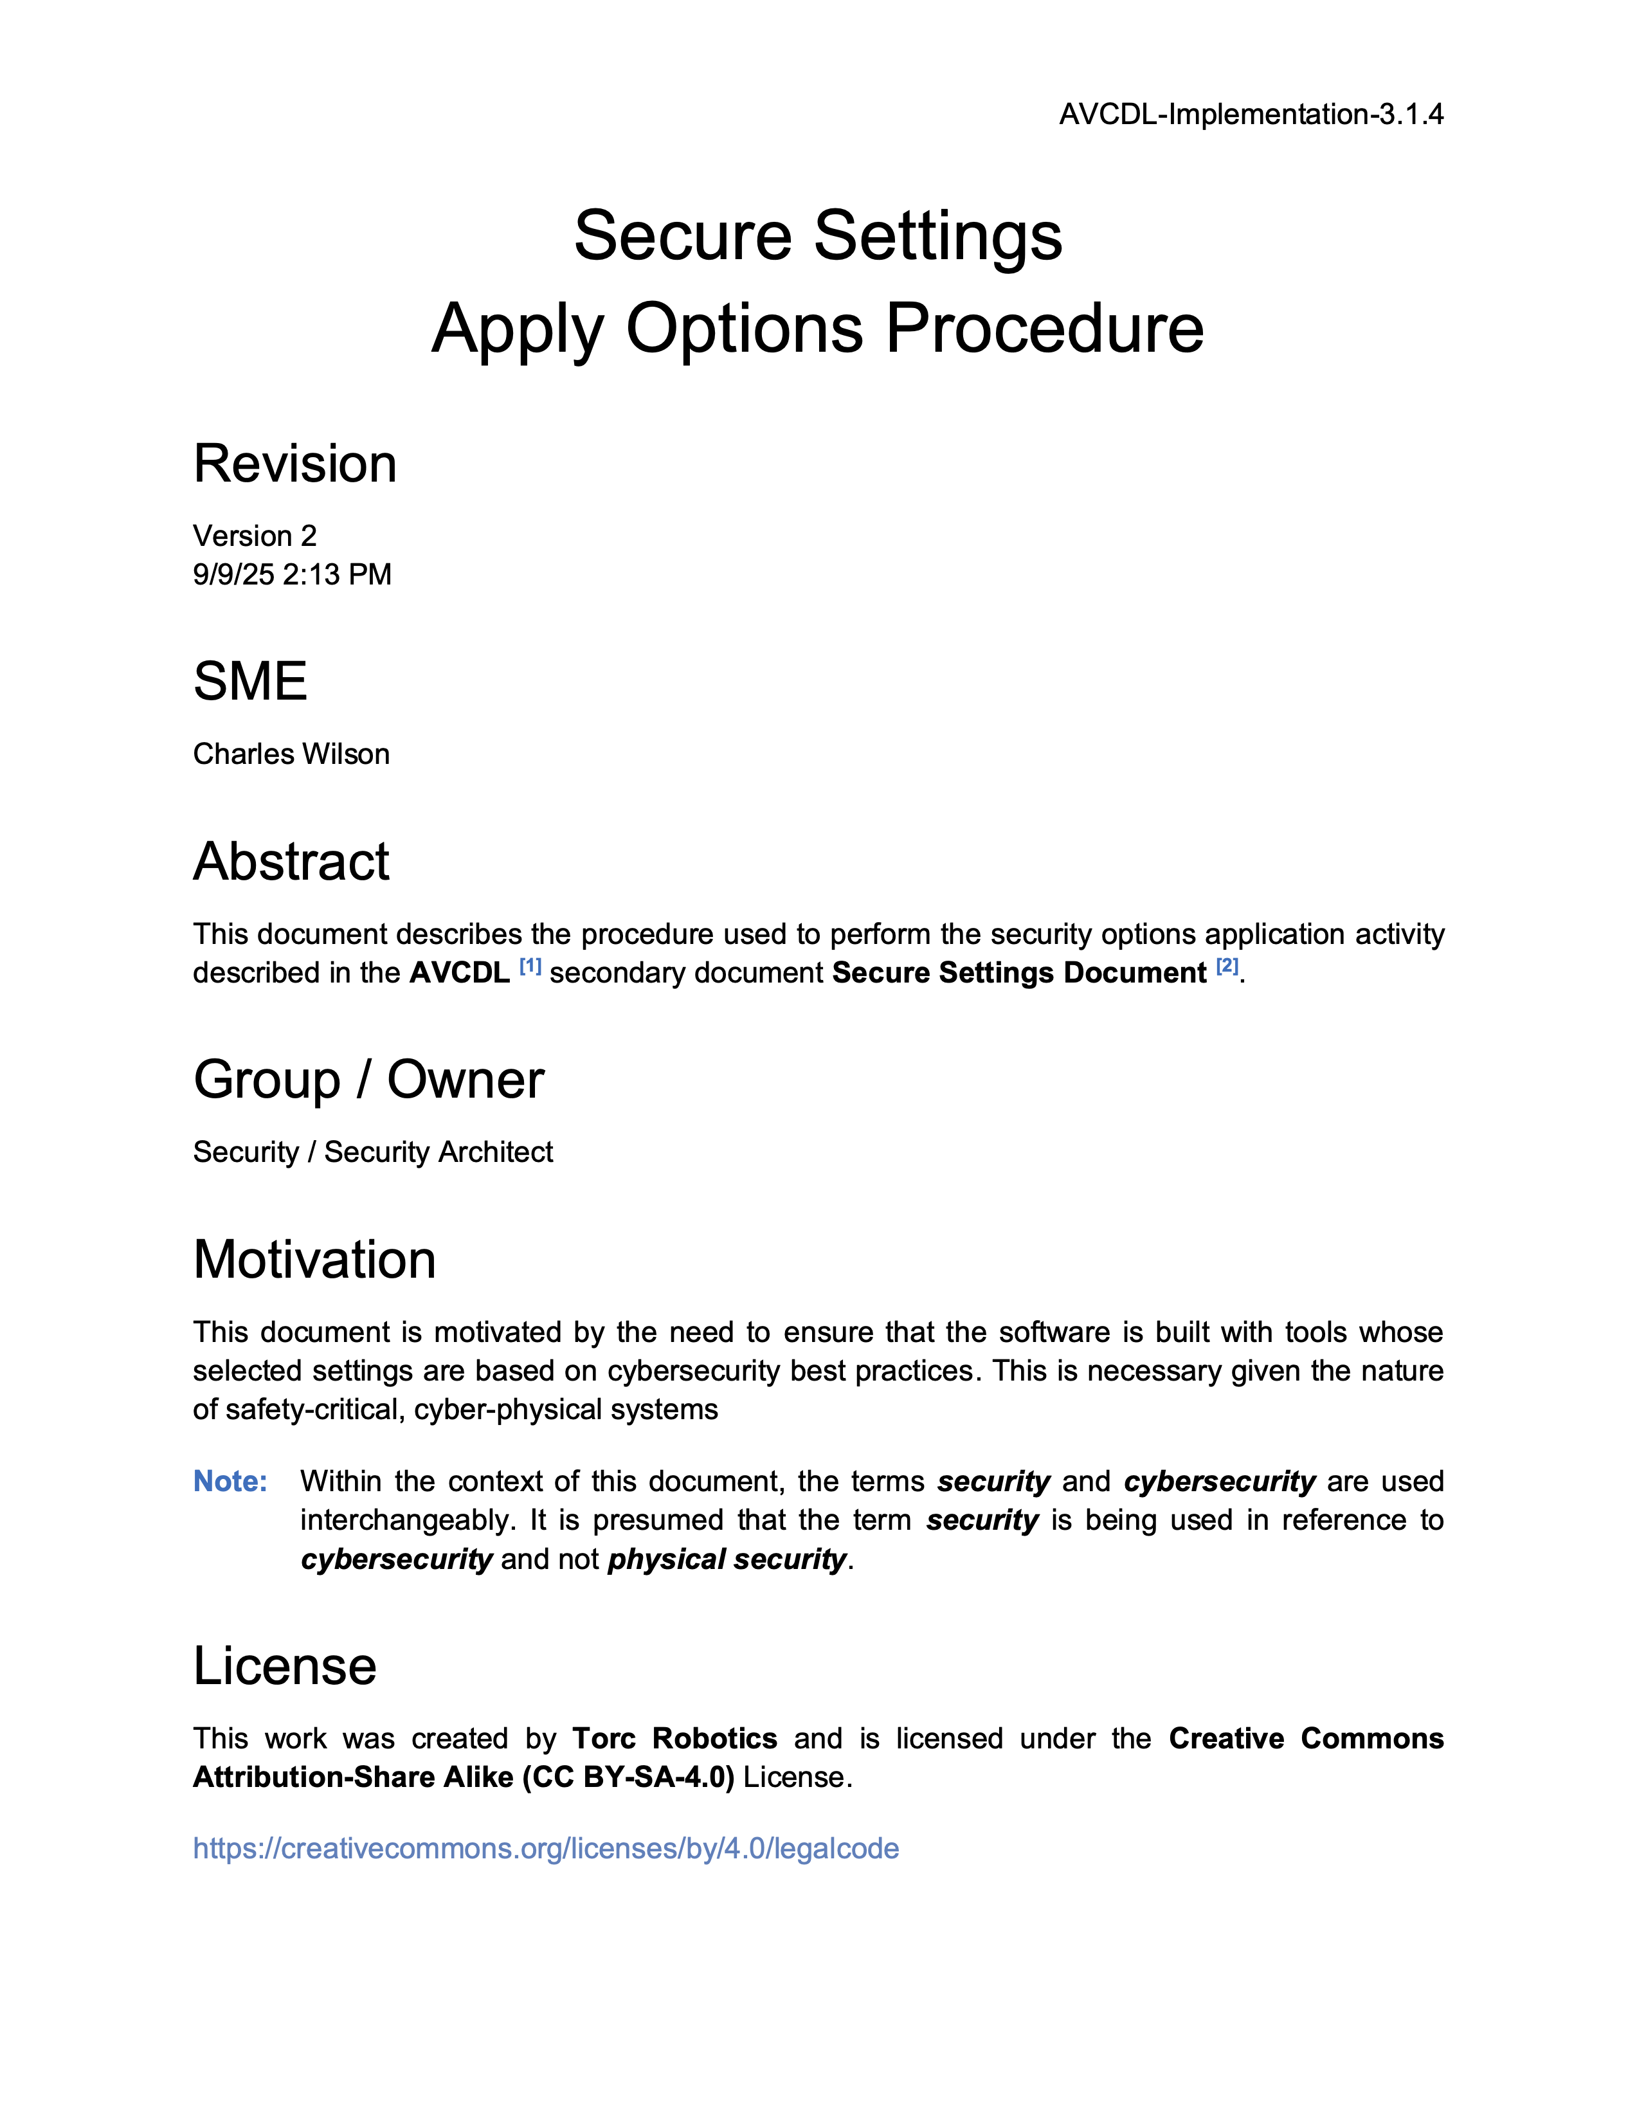
Further Reading
Notes:
Script:
For additional information and to get a more in-depth set of references, the Secure Settings – Apply Options Procedure tertiary document is available in the AVCDL GitHub repository.

Slide 15
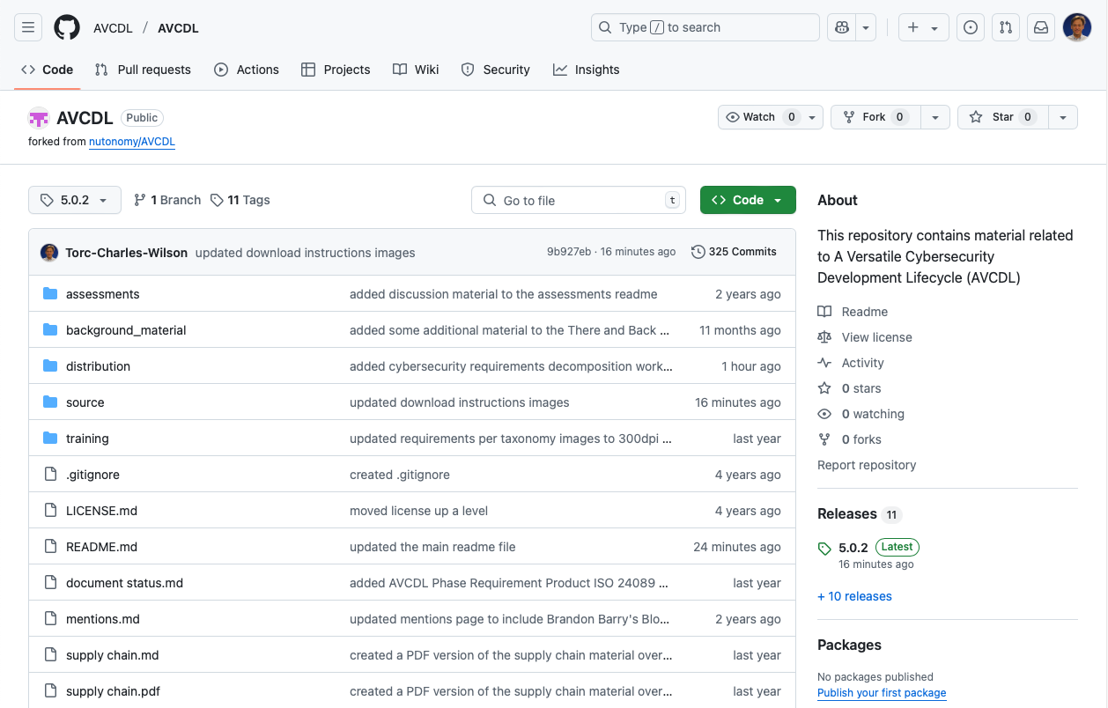
AVCDL on GitHub
https://github.com/AVCDL/AVCDL
Notes:
Script:
All AVCDL materials, both in source and distribution forms, are available on our GitHub site, as shown here.
Because of the size of the repository, it's recommended that you either clone the repository or download a ZIP archive of it, if you're not familiar with using git.
Instructions for downloading a ZIP archive are linked to on the repository’s front page.

Slide 16
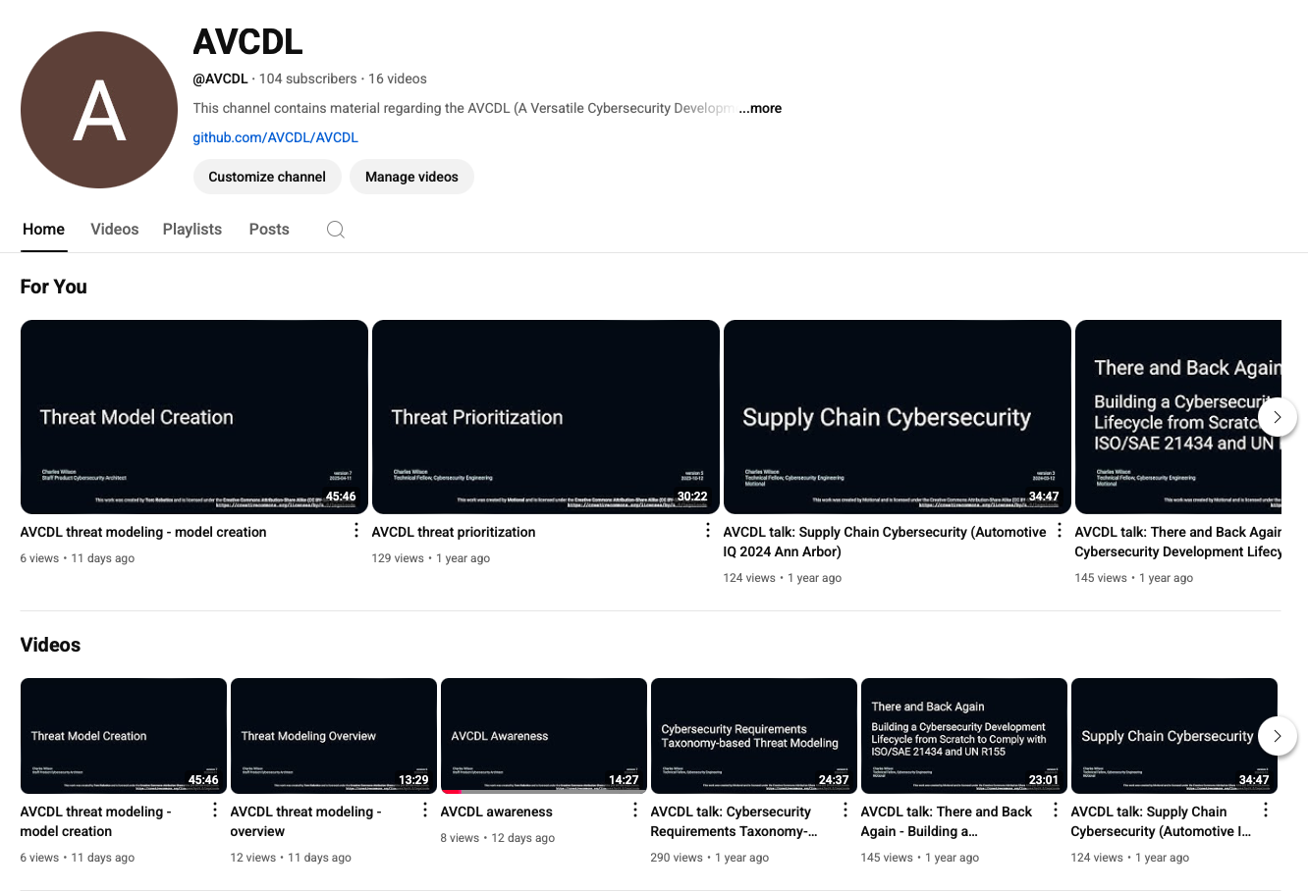
AVCDL on YouTube
https://youtube.com/@AVCDL
Notes:
Script:
Videos covering various aspects of the AVCDL are available on our YouTube channel, as shown here.
It's important to note that all AVCDL materials except for the introductory blog posts are intended for product cybersecurity engineering practitioners.

Slide 17
Next Steps
Notes:
Script:
With this training complete, if you’ve completed the other trainings covering the Secure Settings process activities, you can proceed to the other training at this level, Secure Design Review.
Additionally, if you’ve completed Threat Prioritization, you can also proceed to:
Attack Surface Analysis
Threat Modeling
Penetration Testing
and
Vulnerability Identification
Additionally, you can proceed to either:
Code Reuse
or
Secure Coding

Slide 18
References
AVCDL primary document
Secure Settings Document (AVCDL secondary document)
Secure Settings – Select Options Procedure (AVCDL tertiary document)
Secure Settings – Apply Options Procedure (AVCDL tertiary document)
AVCDL element-specific tool cybersecurity options template (AVCDL template)
Notes:
Script:
Here are references to the source material used in the creation of this presentation.
They'll also be included in the video description.
Additionally, this presentation’s source material will be provided on the AVCDL GitHub repository.

